Slide 1

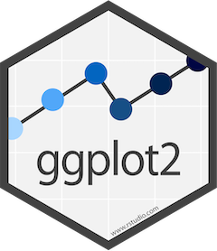
Introduction to ggplot
ggplot2

Slide 2
Why visualising data is important
A picture is worth 1000 words….
Reveals things the stats might not
Easier to grasp for many people
Quickly identify main features, anomalies
Holds an audiences interest more than a wall of text/numbers

Slide 3
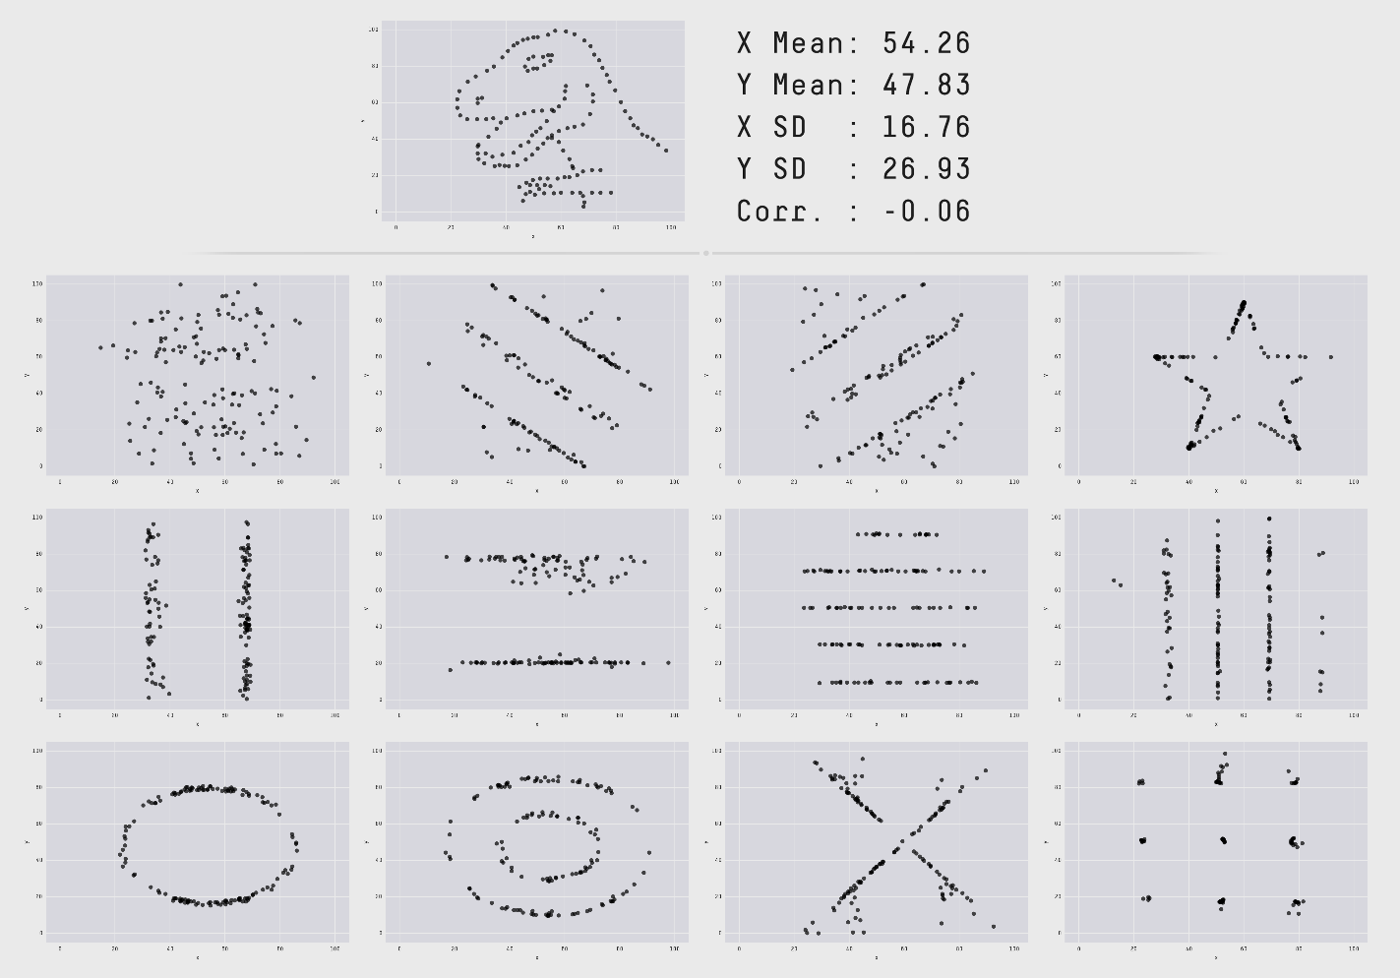
Why visualising data is important
These datasets all have the same mean, median, standard deviation

Slide 4
What is ggplot2
A package for creating plots
Part of tidyverse
Implements “grammar of graphics” to create graphs
- this means a framework following a layered approach to construct visualisations of data

Slide 5
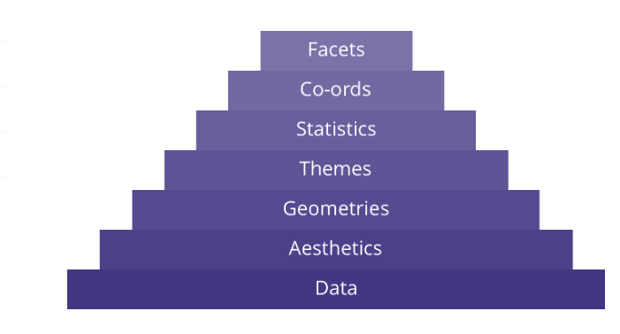
ggplot layers
Subplots based on multiple variables
Coordinate system (cartesian, polar)
e.g. mean, confidence intervals, quantiles
Non-data aesthetics, i.e. plot style, makes things look pretty
Lines, bars , points?
Axes, plot position
The dataset(s)
The dataset(s)

Slide 6
Why ggplot2?
Well developed package
Lots of options/type of graph
Well supported, lots of online resources
E.g.
https://r-graph-gallery.com/ggplot2-package.html
It is not the only package available for graphs, but cover
Notes:
Ggplot is not the only available package for plots by any means. However, it covers most common plot types and many options to modify. Only likely to need another package if doing specific specilised types of plot – eg heatmaps , Sankey diagrams

Slide 7
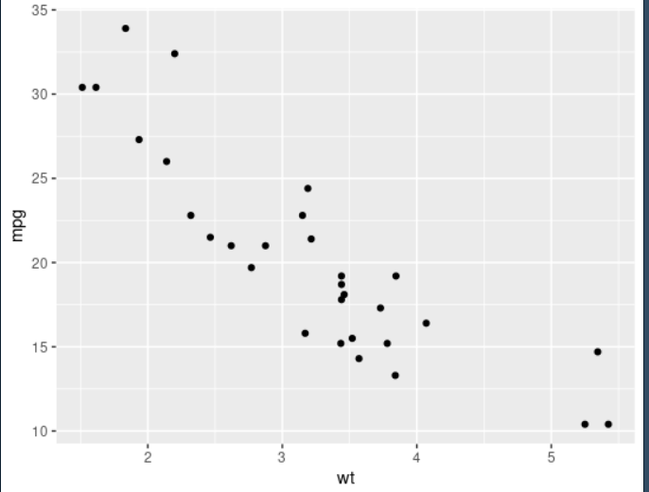
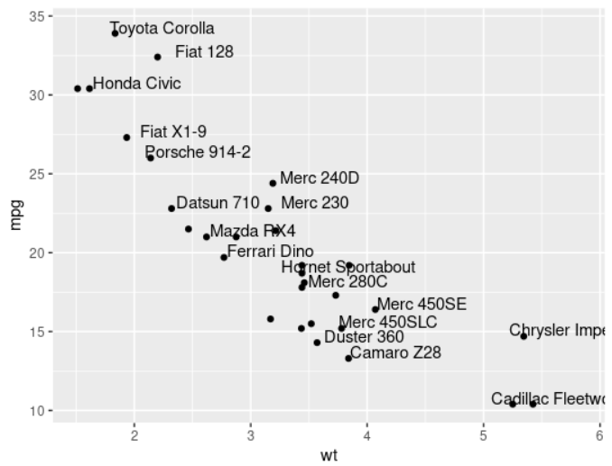
Geom_point example
# Keep 30 first rows in the mtcars natively available dataset
car_data <-head(mtcars, 30)
#add text with geom_text, use nudge to nudge the text
ggplot(data=car_data, aes(x=wt, y=mpg)) +
geom_point() + # Show dots
geom_text(
label=rownames(data),
nudge_x = 0.25, nudge_y = 0.25,
check_overlap = T )
Define your dataset
aes (aesthetics). What are your x and y values?

Slide 8
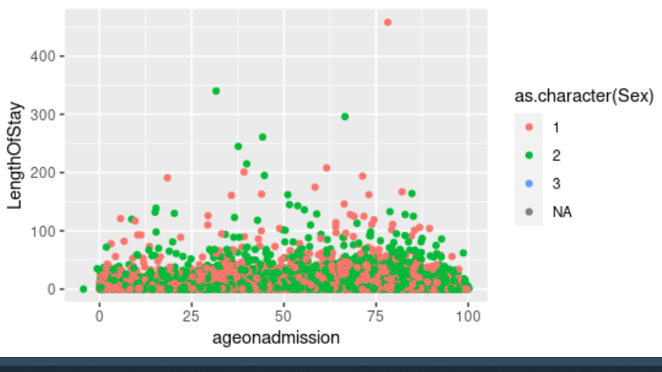
Aesthetics
Commonly use x and y but can add more dimensions, e.g. using colour
borders_data %>%
ggplot(aes(x = ageonadmission, y = LengthOfStay,
colour = as.character(Sex))) + geom_point()

Slide 9
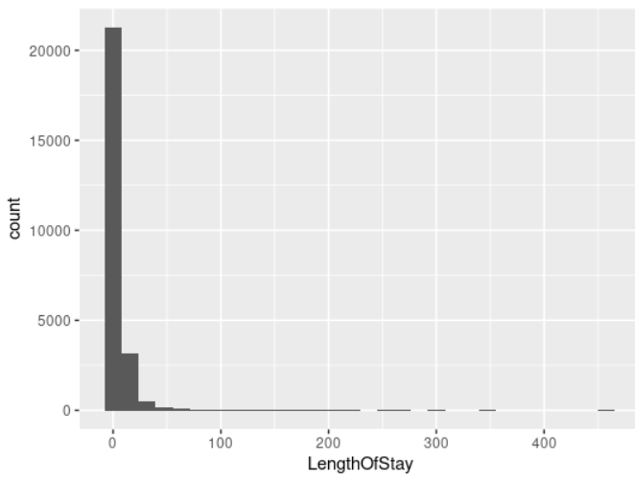
Aesthetics
Histograms use only x….
ggplot(data=borders_data, aes(x= LengthOfStay)) + geom_histogram()

Slide 10
Demo/Exercise 1
We will now go to examples.R to look at a few different graph types in ggplot
Notes:
Enough talking – time to look at what ggplot can do

Slide 11
Geometry layers
These are the geom_ functions that we have already used: gemo_bar, geom_line etc.
There are ~50 options!
You will probably only use a few of these frequently

Slide 12
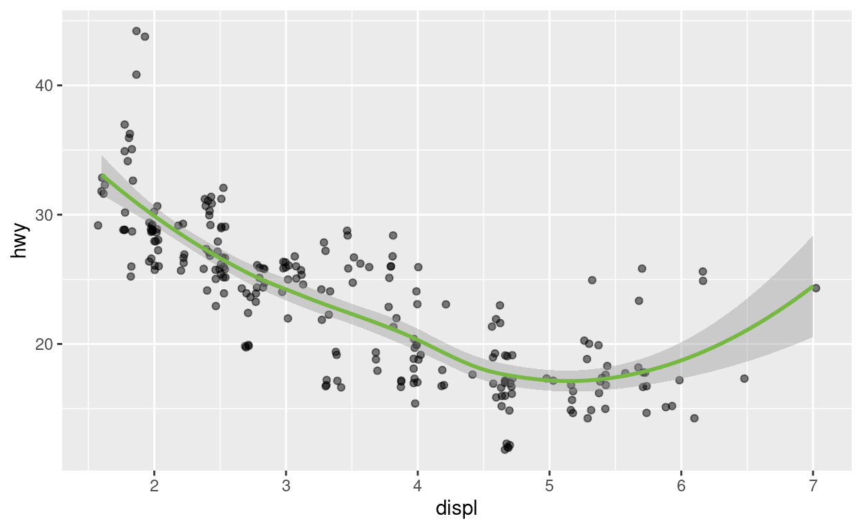
Geometry layers
Adding multiple geom layers to one plot:
ggplot(data = car_data, mapping =
aes(x = displ, y = hwy)) +
geom_point(position = position_jitter(),alpha = 0.5) +
geom_smooth(colour = "#76B843")

Slide 13
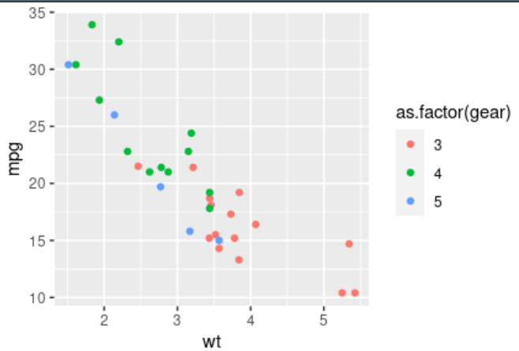
Mapping vs aesthetics
Aesthetic mappings describe how properties of the data connect with features of the graph, such as distance along an axis, size of points, or colour.
The aes() function connects data with what we see on the graph by defining aesthetic mappings and will be one of the most often used functions when you’re creating data visualisations.
ggplot(car_data, aes(x=wt, y=mpg, colour=as.factor(gear) ) +
geom_point()#

Slide 14
Aesthetic mapping options
Some of the options available for aesthetic mapping in ggplot
Aesthetic | Description
x | The x axis position
y | The y axis position
colour | Colour of points, outlines of other geoms
fill | The colour of the fill
size | Area or radius of points, thickness of lines
alpha | The level of transparency (out of 1)
linetype | The pattern used for drawing lines (solid, dashed, dotdash, etc.)
shape | The shape of points, some of which allow a fill to be specified
labels | Text on the plot or axes

Slide 15
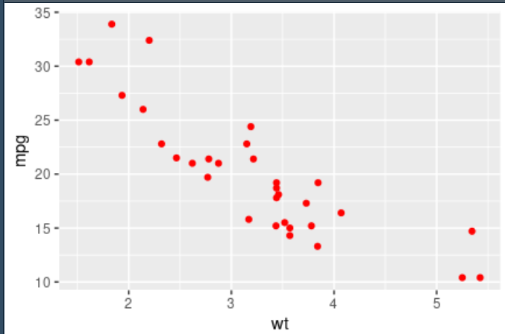
Aesthetic vs mapping
ggplot(data, aes(x=wt, y=mpg)) +
geom_point(colour=“red”)
Many of these aesthetics function as both aesthetic mappings but also attributes.
“Mapping” = mapping (relating) some aspect of the data to how it is visualized on the plot e.g. colour the points according to sex
An attribute, determining how something looks not related to data values
e.g. making all the points red
an attribute should be defined as part of the geom and not in the aes() function.

Slide 16
Further aesthetics options
Many other options:
Jittering points to deal with many overlapping points
Changing what values the axes start on/go to
Changing to e.g. a log scale
IMPORTANT – all these kinds of modifications are specific to a data layer rather than global attributes. Therefore they will be specified inside geom_<type>, not inside ggplot(), and they will be specified outside of aes()

Slide 17
Positions
It’s quite common to adjust position, this is how you can account for overlapping data. The default position is “identity” which means that it takes the value exactly as it is in the data to position within the plot. There are a number of other options available though:
Function | Description
position_dodge() position_dodge2() | Dodge overlapping objects side-to-side, preserving the vertical position. The position_dodge() version requires a grouping in the data, position_dodge2() doesn’t
position_identity() | No adjustment to position (default)
position_jitter() | A pseudo-randomisation of points to seperate them
position_jitterdodge() | Simultaneously dodge and jitter
position_nudge() | Nudge points a fixed distance
position_stack() | Stacks bars on top of each other
position_fill() | Stacks bars and standardises each stack to have constant height

Slide 18
Exercise 2
exercise 2 in the exercises file, or the exercise that comes after the “positions” section on the aesthetics page of the app
Notes:
Enough talking – time to look at what ggplot can do

Slide 19
Scales and axes
Scales affect how the aesthetics are set up and control visual properties of the data values.
Functions of the type scale_<name>_<data_type>
E.g. scale_x_contiuous(), scale_y_discrete(), scale_colour_continuous()
Within these you can define things such as: limits of the axes, labels and axis titles, colour palette,
There are many, many scale options/ functions – do not try and memorise them all, just be aware that they are available!

Slide 20
Exercise 3
exercise 3 in the exercises file, or the exercise that comes after the “scale” section on the aesthetics page of the app
Notes:
Enough talking – time to look at what ggplot can do

Slide 21
Themes
Make the plot look pretty!
You can change all the individual items: plot titles, subtitles, axis title, legend title, legend position, axis line type, line thickness, grid lines, plot background colour…. etc etc
Each element has its own name and can be accessed through the theme() function.
You can edit multiple items individually, but some are also grouped so that you can alter properties without going into every item in the group:
E.g. you could alter axis text size by using the function axis.title(), OR if you wanted to edit the x axis title and the y axis title separately, you could use axis.title.x() and axis.title.y()

Slide 22
Themes
Type | Top Level Function | 2nd Level Function
Text | axis.title() | axis.title.x()
 |  | axis.title.y()
 | axis.text() | axis.text.x()
 |  | axis.text.y()
 | legend.text()
 | plot.title()
Line | axis.ticks() | axis.ticks.x()
 |  | axis.ticks.y()
 | axis.line() | axis.line.x()
 |  | axis.line.y()
 | panel.grid() | panel.grid.major()
 |  | panel.grid.minor()
Rect | legend.background()
 | panel.background()
 | plot.background()
Some example functions available in theme()

Slide 23
Themes
https://github.com/Public-Health-Scotland/phsstyles
theme_phs()

Slide 24
Themes Demo/Exercise
Exercise 4

Slide 25
Summary – key points for ggplot code
Always starts with ggplot()
The “+” goes at the end of the line, always
ggplot(data, aes(x=wt, y=mpg)) +
geom_point(colour=“red”) +
theme_phs()
ggplot() +
geom_point(data, aes(x=wt, y=mpg), colour=“red”) +
theme_phs()
Need at least one geom_ layer
Always need data and aes() …..
These can go in ggplot() and be applied to all layers (unless specified otherwise), or be added to each geom_ (useful in more complex plots)
Add titles, labels to make your plot more easily readable
Lots of options to modify the appearance…. Use cheatsheets, resources on next slide, google and ?help in R to find the functions you need and how to use them

Slide 26
Resources
https://ggplot2.tidyverse.org/ overview and cheat sheets
https://www.data-to-viz.com/
Information to help you decide on the most appropriate graph for your data. Common errors to avoid. Links to code
https://r-graph-gallery.com/
Examples of different graph types with code
R for Data Science (2e) - 2 Data visualization (hadley.nz) – book chapter with code, reproducible examples and exercises.

